Slide 1




Mobile Price Dataset
PRIYADARSHINI M
DA/DS, Milestone-1,(Python Data exploration project)
06.11.2024

Slide 2

Introduction
This project analyzes mobile phone specifications (battery, RAM, screen size, camera, etc.) to understand how these features relate to price or market category.

Slide 3
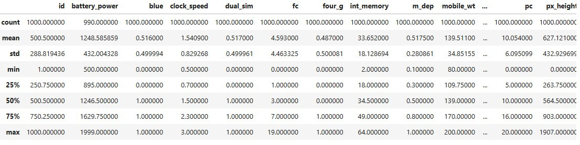
Data Understanding
Number of Rows and Columns : (1000, 21)
Data Types : integer, float
Summary Statistics :

Slide 4
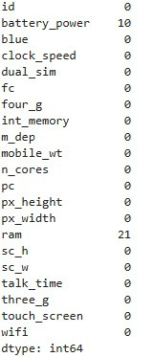
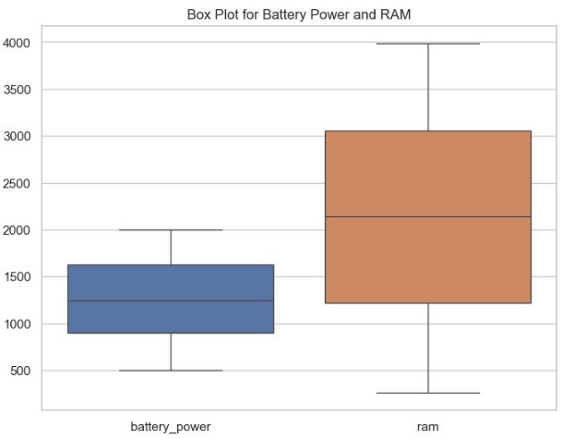
Initial Exploration
Missing Values :
Outlier :

Slide 5

Missing Values Handling
Techniques to Detect Missing Values - df.isna().sum()
Techniques to Handle Missing Values :

Slide 6
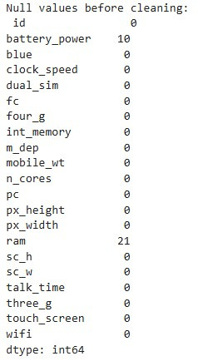
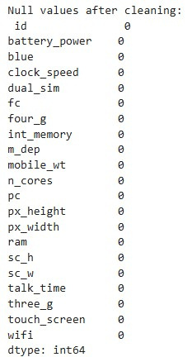
Before & After Comparison

Slide 7
Outlier Handling
Identification Strategies
Handling Techniques
Impact

Slide 8
Handling Invalid Values
Found invalid values through range and type checks.
Imputed invalid values with the mean or capped excessive values at realistic limits.
Replaced negative battery_power values with the mean; capped excessive RAM values to keep data within a reasonable range.

Slide 9
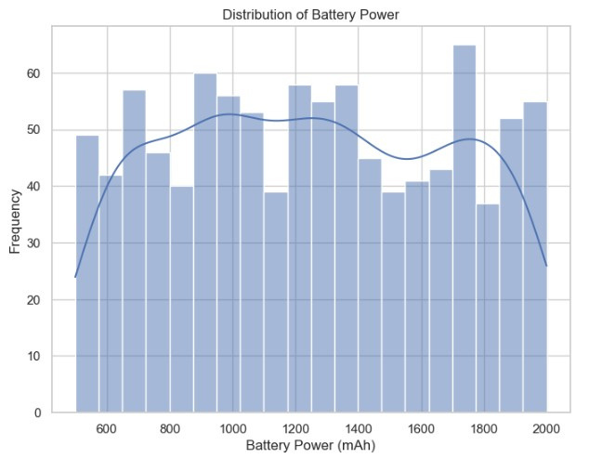
Data Visualization
Univariate Analysis - Histogram of Battery Power

Slide 10
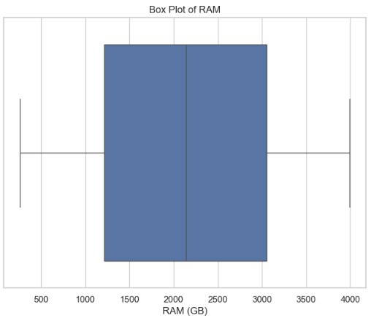
Segmented Univariate Analysis - Box Plot of RAM

Slide 11
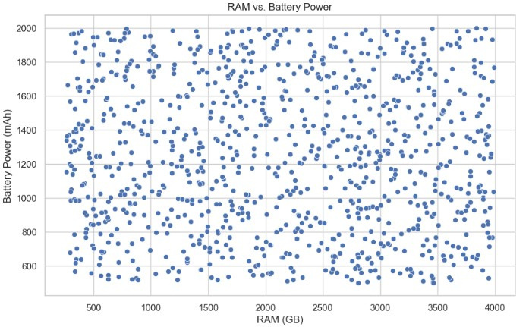
Bivariate Analysis - Scatter Plot of RAM vs. Battery Power

Slide 12
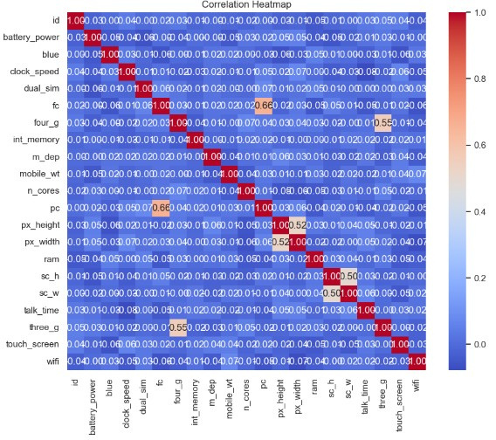
Multivariate Analysis - Heatmap of Correlation Matrix

Slide 13
What is the primary focus of this dataset?
This dataset focuses on mobile phone specifications, including attributes.
2. What types of values are present in the dataset?
The dataset contains numerical values (e.g., battery power, RAM), categorical values (e.g., 4G/5G connectivity), and derived metrics for enhanced analysis.
3. Are there any strong correlations in the dataset?
Yes, higher RAM tends to correlate with better performance and battery capacity.
4. How does RAM influence phone performance?
Higher RAM typically leads to better performance, as it supports faster processing and multitasking.

Slide 14
Thank You

